Slide 1
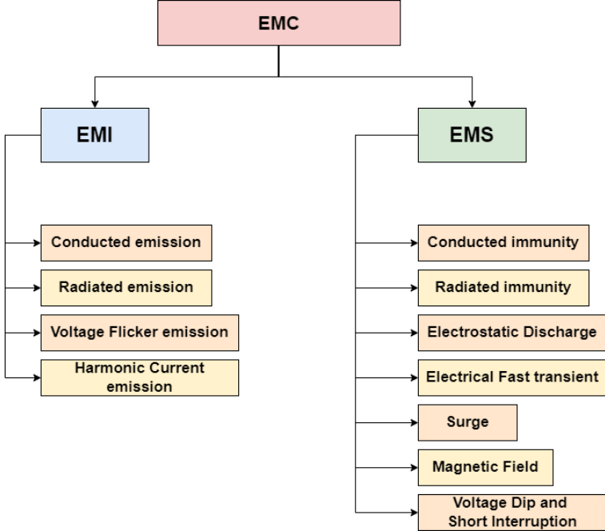
Machine learning measures for EMC solutions
A Multi-Model Approach to Electromagnetic Compatibility
Markosyan Arman

Slide 2
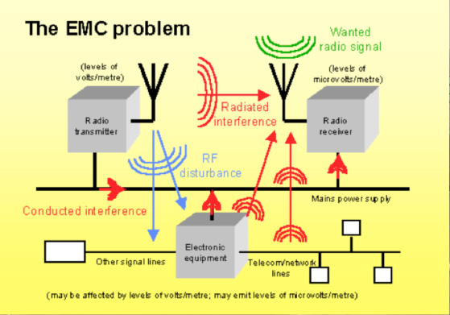
The Challenge in EMC
The Problem: Traditional solvers (FEM, SPICE) are slow and computationally expensive. Pure Deep Learning ignores physics laws.
Solution:
Space: Predicting IR-Drop on chips instantly.
Time: Modeling Crosstalk in transmission lines.
Physics: Simulating Wave Propagation without data.

Slide 3
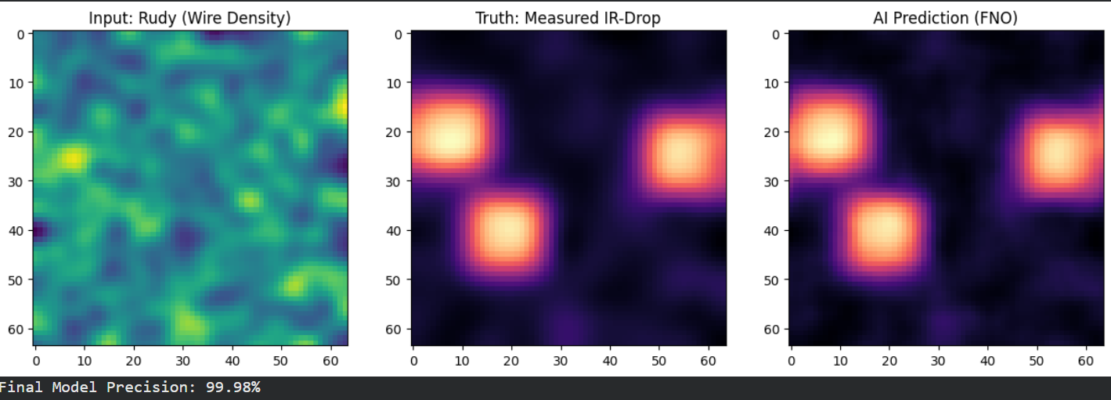
Model 1 Spatial Operator Learning (FNO)
Problem: Conducted Emissions (IR-Drop) in VLSI Circuits.
Method: Fourier Neural Operator (FNO). Learns the mapping from Geometry (Rudy density) to Voltage Field globally in the frequency domain.

Slide 4
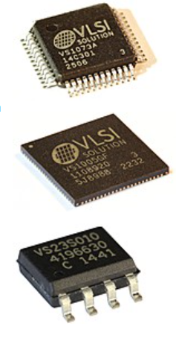
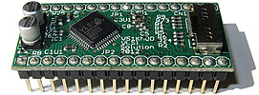
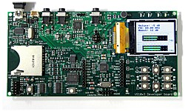
Model 1 Spatial Operator Learning (FNO)

Slide 5
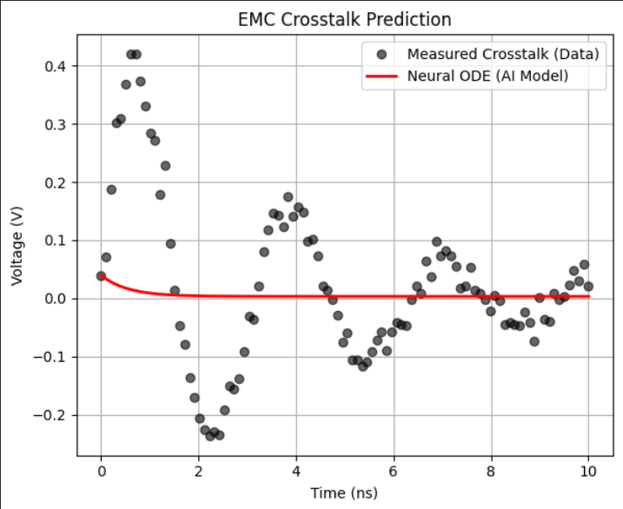
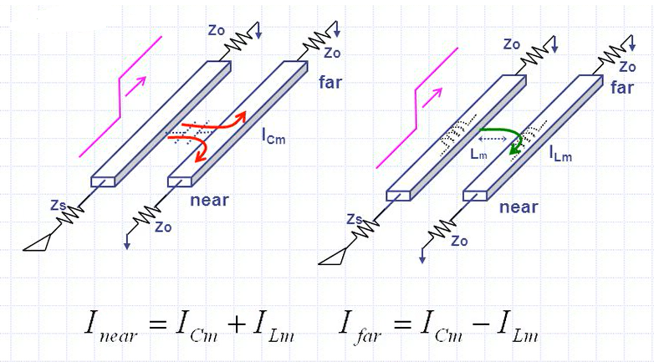
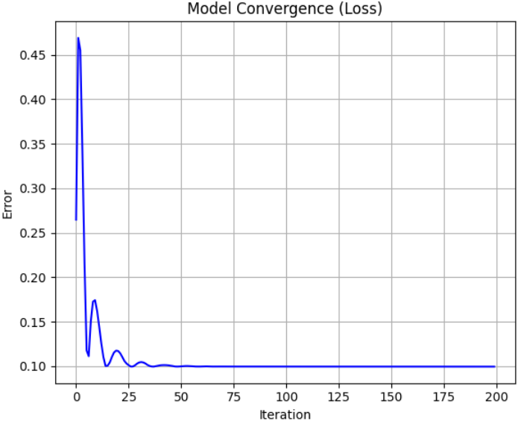
Model 2 Temporal Dynamics (Neural ODE)
Problem: Crosstalk & Signal Integrity in Transmission Lines.
Method: Neural Ordinary Differential Equations (Neural ODE).
Goal: To create a model capable of learning the underlying differential equation from noisy measurements.

Slide 6
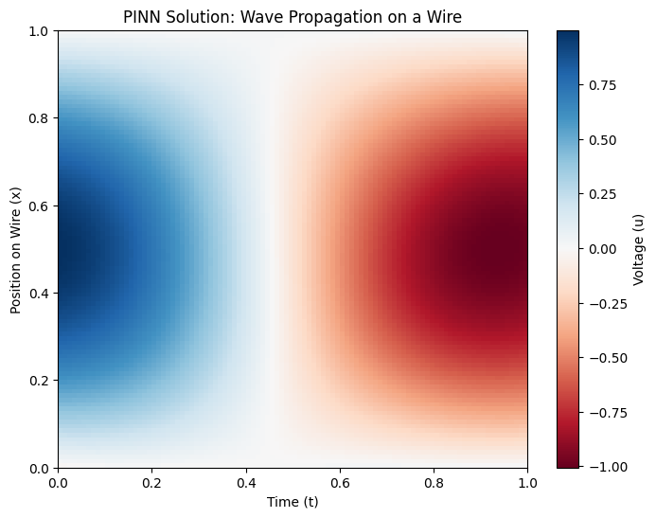
Model 3 using the PINN method
Fundamental Wave Propagation (1D Wave Equation)
PINN Minimizes residual error

Slide 7
Comparative Analysis of Models
Model 1
Focus: Chip Geometries & Voltage Maps (CircuitNet)
Learns in the frequency domain
Predicts full-field distributions
Model 2
Focus: Signal Integrity & Crosstalk (NASA Data)
Learns the continuous derivative
Handles noisy, irregular sensor data
Model 3
Focus: Fundamental Wave Propagation.
Minimizes residual error of the Wave Equation

Slide 8
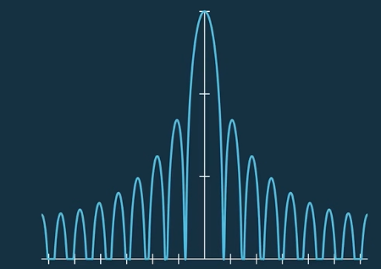
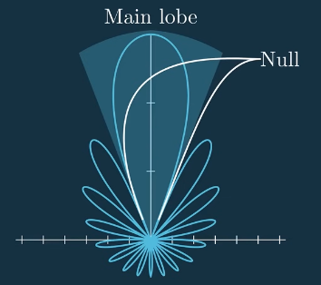
Practical Impact & Future Work (HF)
Accelerates EMC compliance testing
Reduces reliance on expensive commercial solvers
Combine PINN with FNO (Physics-Informed Operators).
3D Enclosure Shielding
Antenna radiation calculation and simulation (implementation of models in the high-frequency range)
Practical Implementation

